Slide 1
CS 152 Computer Architecture and Engineering CS252 Graduate Computer Architecture Lecture 7 – Memory III
Krste Asanovic
Electrical Engineering and Computer Sciences
University of California at Berkeley
http://www.eecs.berkeley.edu/~krste
http://inst.eecs.berkeley.edu/~cs152

Slide 2
Last time in Lecture 6
3 C’s of cache misses
Compulsory, Capacity, Conflict
Write policies
Write back, write-through, write-allocate, no write allocate
Pipelining write hits
Multi-level cache hierarchies reduce miss penalty
3 levels common in modern systems (some have 4!)
Can change design tradeoffs of L1 cache if known to have L2
Inclusive versus exclusive cache hierarchies

Slide 3
CS152 Administrivia
PS 1 solutions discussed in section on Friday
Lab 1 due 11:59PM Wed Feb 17
PS 2 out today
Monday Feb 15 is President’s Day Holiday, no class!

Slide 4
CS252 Administrivia
Start thinking of class projects and forming teams of two
Use Krste’s office hours to discuss ideas
Email for Zoom link
Proposal due Wednesday February 24th

Slide 5
Guest Lecturers Today
Will cover prefetching
Following slides provided from last year as additional material.

Slide 6
Recap: Multilevel Caches
Problem: A memory cannot be large and fast
Solution: Increasing sizes of cache at each level
DRAM
CPU
L2$
L1$
Local miss rate = misses in cache / accesses to cache
Global miss rate = misses in cache / CPU memory accesses
Misses per instruction = misses in cache / number of instructions
Notes:
MPI makes it easier to compute overall performance (jse)

Slide 7
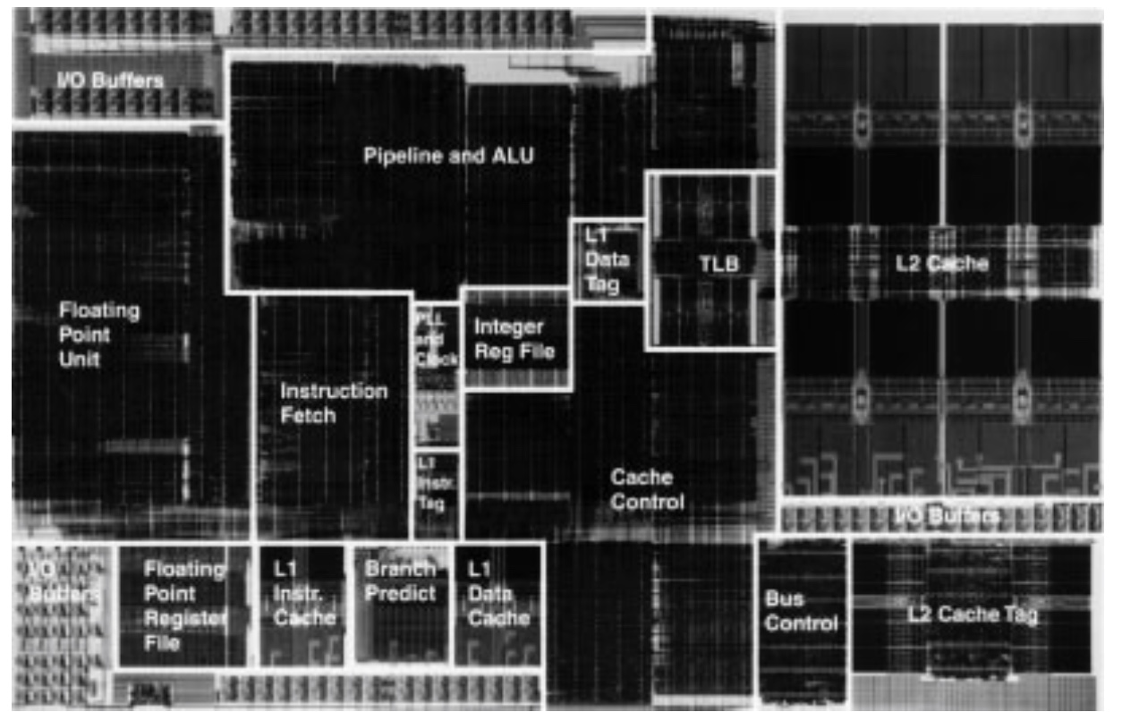
Exponential X704 PowerPC Processor (1997)
32KB L2 8-way Set-Associative Write-Back Unified Cache
0.5µm BiCMOS
Ran at 410-533MHz when other PC processors were much lower clock rate
Project delayed –missed market window for Apple
2KB L1 Direct-Mapped Instruction Cache
2KB L1 Direct-Mapped Write-Through Data Cache

Slide 8
Victim Caches (HP 7200)
CPU
Unified L2 Cache
L1 Data Cache
RF
Evicted data
from L1
Victim
FA Cache
4 blocks
to where?
Hit data from VC (miss in L1)
Evicted data
from VC
Victim cache is a small associative backup cache, added to a direct-mapped cache, which holds recently evicted lines
First look up in direct-mapped cache
If miss, look in victim cache
If hit in victim cache, swap hit line with line now evicted from L1
If miss in victim cache, L1 victim -> VC, VC victim->?
Fast hit time of direct mapped but with reduced conflict misses

Slide 9
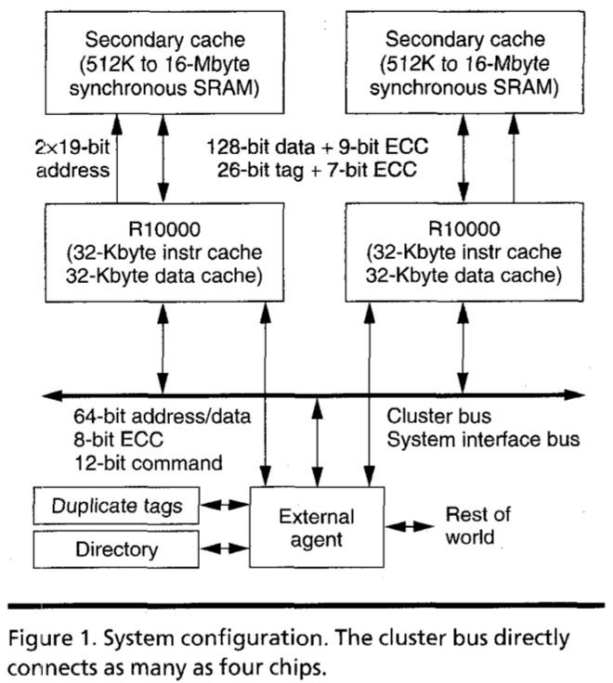
MIPS R10000 Off-Chip L2 Cache (Yeager, IEEE Micro 1996)

Slide 10
Way-Predicting Caches (MIPS R10000 L2 cache)
Use processor address to index into way-prediction table
Look in predicted way at given index, then:
HIT
MISS
Return copy
of data from
cache
Look in other way
Read block of data from
next level of cache
MISS
SLOW HIT
(change entry in prediction table)

Slide 11
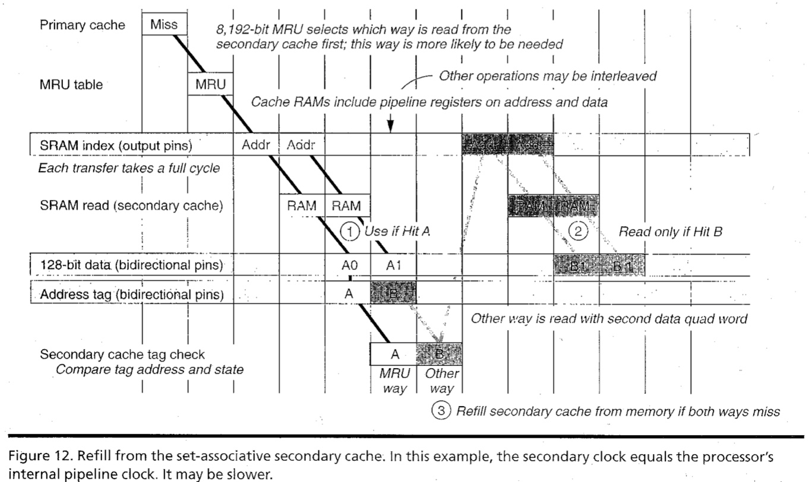
R10000 L2 Cache Timing Diagram

Slide 12
Way-Predicting Instruction Cache (Alpha 21264-like)
Jump target
Store last-used way for sequential path and predicted branch taken path. Can be fetching multiple instructions per cycle.
0x4
Jump control
Add
PC
addr
inst
Primary
Instruction
Cache
way
Sequential Way
Branch Target Way

Slide 13
Reduce Miss Penalty of Long Blocks: Early Restart and Critical Word First
Don’t wait for full block before restarting CPU
Early restart—As soon as the requested word of the block arrives, send it to the CPU and let the CPU continue execution
Critical Word First—Request the missed word first from memory and send it to the CPU as soon as it arrives; let the CPU continue execution while filling the rest of the words in the block
Long blocks more popular today ⇒ Critical Word 1st Widely used
To CPU
To CPU
Word 0
Word 2
Word 1
Word 3
Word 2
Word 0
Rest of line filled in with wrap-around on cache line
Word 3
Word 1

Slide 14
Increasing Cache Bandwidth with Non-Blocking Caches
Non-blocking cache or lockup-free cache allow data cache to continue to supply cache hits during a miss
requires Full/Empty bits on registers or out-of-order execution
“hit under miss” reduces the effective miss penalty by working during miss vs. ignoring CPU requests
“hit under multiple miss” or “miss under miss” may further lower the effective miss penalty by overlapping multiple misses
Significantly increases the complexity of the cache controller as there can be multiple outstanding memory accesses, and can get miss to line with outstanding miss (secondary miss)
Requires pipelined or banked memory system (otherwise cannot support multiple misses)
Pentium Pro allows 4 outstanding memory misses
Cray X1E vector supercomputer allows 2,048 outstanding memory misses

Slide 15
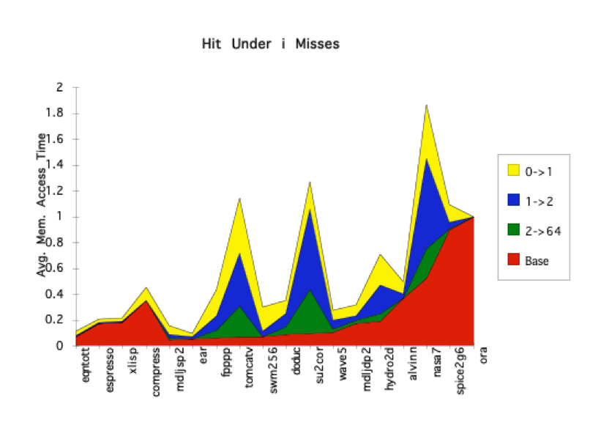
Value of Hit Under Miss for SPEC (old data)
“Hit under n Misses”
Floating Point
0->1
1->2
2->64
Base
Integer
FP programs on average: AMAT= 0.68 -> 0.52 -> 0.34 -> 0.26
Int programs on average: AMAT= 0.24 -> 0.20 -> 0.19 -> 0.19
8 KB Data Cache, Direct Mapped, 32B block, 16 cycle miss, SPEC 92

Slide 16
Prefetching
Speculate on future instruction and data accesses and fetch them into cache(s)
Instruction accesses easier to predict than data accesses
Varieties of prefetching
Hardware prefetching
Software prefetching
Mixed schemes
What types of misses does prefetching affect?
Notes:
Reduces compulsory misses, can increase conflict and
capacity misses.

Slide 17
Issues in Prefetching
Usefulness – should produce hits
Timeliness – not late and not too early
Cache and bandwidth pollution
L1 Instruction
Unified L2 Cache
CPU
L1 Data
RF
Prefetched data

Slide 18
Hardware Instruction Prefetching
Instruction prefetch in Alpha AXP 21064
Fetch two lines on a miss; the requested line (i) and the next consecutive line (i+1)
Requested line placed in cache, and next line in instruction stream buffer
If miss in cache but hit in stream buffer, move stream buffer line into cache and prefetch next line (i+2)
Prefetched
instruction line
Req
line
Stream
Buffer
CPU
Unified L2 Cache
L1 Instruction
RF
Req
line
Notes:
Need to check the stream buffer if the requested line is in there.
Never more than one 32-byte line in the stream buffer.

Slide 19
Hardware Data Prefetching
Prefetch-on-miss:
Prefetch b + 1 upon miss on b
One-Block Lookahead (OBL) scheme
Initiate prefetch for block b + 1 when block b is accessed
Why is this different from doubling block size?
Can extend to N-block lookahead
Strided prefetch
If observe sequence of accesses to line b, b+N, b+2N, then prefetch b+3N etc.
Example: IBM Power 5 [2003] supports eight independent streams of strided prefetch per processor, prefetching 12 lines ahead of current access
Notes:
HP PA 7200 uses OBL prefetching
Tag prefetching is twice as effective as prefetch-on-miss in
reducing miss rates.

Slide 20
Software Prefetching
for(i=0; i < N; i++) { prefetch( &a[i + 1] ); prefetch( &b[i + 1] ); SUM = SUM + a[i] * b[i]; }
Notes:
Cache should be non-blocking or lockup-free.
By that we mean that the processor can proceed while the prefetched
Data is being fetched; and the caches continue to supply instructions
And data while waiting for the prefetched data to return.

Slide 21
Software Prefetching Issues
Timing is the biggest issue, not predictability
If you prefetch very close to when the data is required, you might be too late
Prefetch too early, cause pollution
Estimate how long it will take for the data to come into L1, so we can set P appropriately
Why is this hard to do?
for(i=0; i < N; i++) { prefetch( &a[i + P] ); prefetch( &b[i + P] ); SUM = SUM + a[i] * b[i]; }
Must consider cost of prefetch instructions

Slide 22
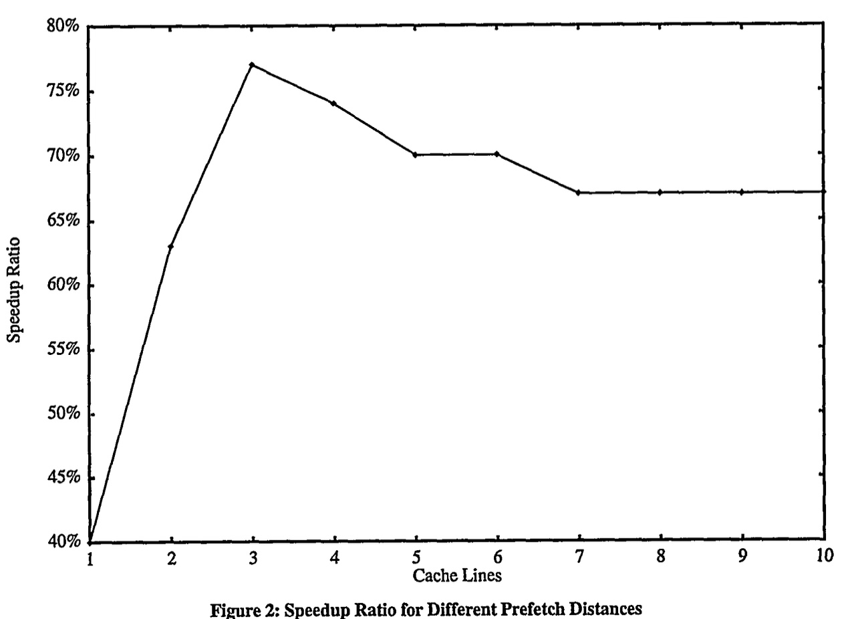
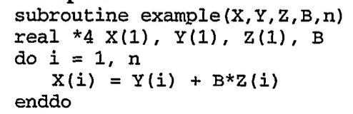
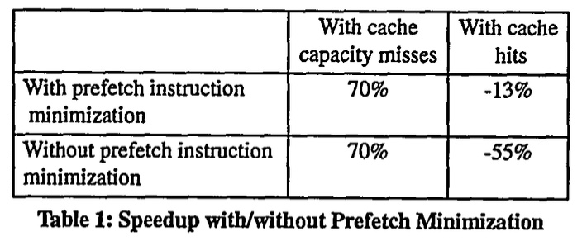
Software Prefetching Example
[“Data prefetching on the HP PA8000”, Santhanam et al., 1997]

Slide 23
Compiler Optimizations
Restructuring code affects the data access sequence
Group data accesses together to improve spatial locality
Re-order data accesses to improve temporal locality
Prevent data from entering the cache
Useful for variables that will only be accessed once before being replaced
Needs mechanism for software to tell hardware not to cache data (“no-allocate” instruction hints or page table bits)
Kill data that will never be used again
Streaming data exploits spatial locality but not temporal locality
Replace into dead cache locations
Notes:
Miss-rate reduction without any hardware changes.
Hardware designer’s favorite solution.

Slide 24
Loop Interchange
for(j=0; j < N; j++) { for(i=0; i < M; i++) { x[i][j] = 2 * x[i][j]; } }
for(i=0; i < M; i++) { for(j=0; j < N; j++) { x[i][j] = 2 * x[i][j]; } }
What type of locality does this improve?

Slide 25
Loop Fusion
for(i=0; i < N; i++) a[i] = b[i] * c[i];
for(i=0; i < N; i++)
d[i] = a[i] * c[i];
for(i=0; i < N; i++) { a[i] = b[i] * c[i]; d[i] = a[i] * c[i];
}
What type of locality does this improve?

Slide 26
Matrix Multiply, Naïve Code
z
j
for(i=0; i < N; i++) for(j=0; j < N; j++) { r = 0; for(k=0; k < N; k++) r = r + y[i][k] * z[k][j]; x[i][j] = r; }
k
y
k
x
j
i
i
Not touched
Old access
New access

Slide 27
Matrix Multiply with Cache Tiling
for(jj=0; jj < N; jj=jj+B) for(kk=0; kk < N; kk=kk+B) for(i=0; i < N; i++) for(j=jj; j < min(jj+B,N); j++) { r = 0; for(k=kk; k < min(kk+B,N); k++) r = r + y[i][k] * z[k][j]; x[i][j] = x[i][j] + r; }
z
j
k
y
k
x
j
i
i
What type of locality does this improve?
Notes:
Y benefits from spatial locality
z benefits from temporal locality

Slide 28
Acknowledgements
This course is partly inspired by previous MIT 6.823 and Berkeley CS252 computer architecture courses created by my collaborators and colleagues:
Arvind (MIT)
Joel Emer (Intel/MIT)
James Hoe (CMU)
John Kubiatowicz (UCB)
David Patterson (UCB)

